Slide 1
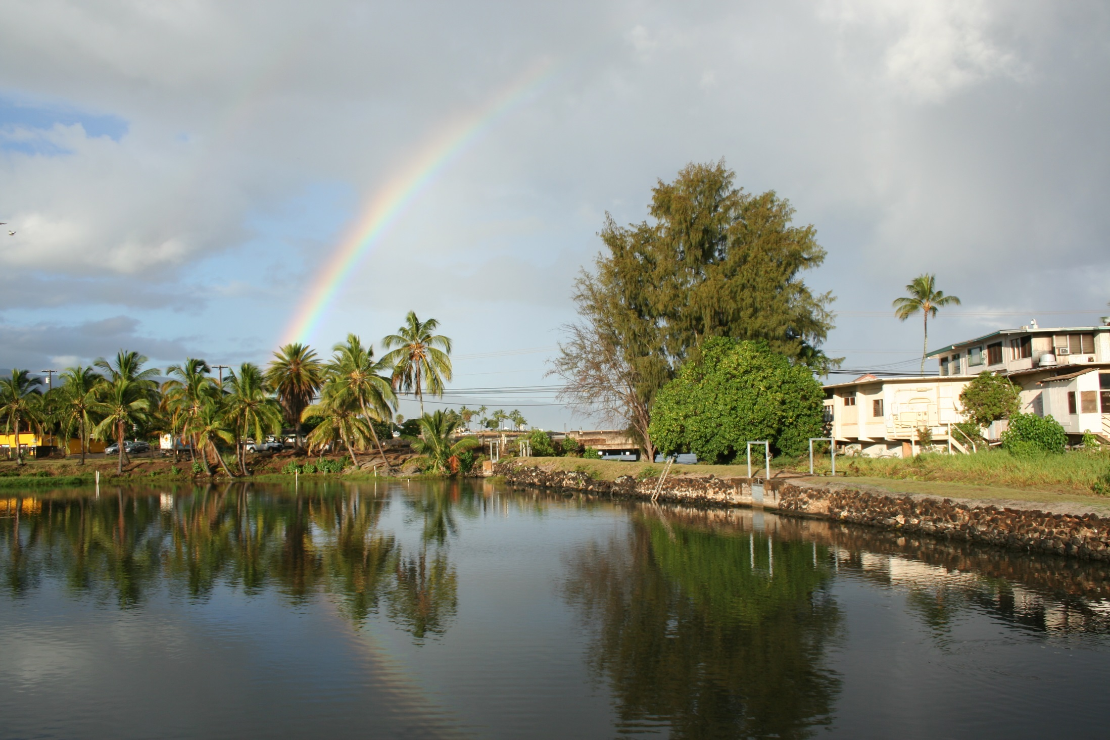
Continuity and Change at a Pu‘uone Fishpond: New Archaeological Data from Lokoea, Kawailoa, O‘ahu
Christopher M. Monahan, Ph.D.
TCP Hawai`i, LLC
3 October 2013
Kamehameha Schools

Slide 2
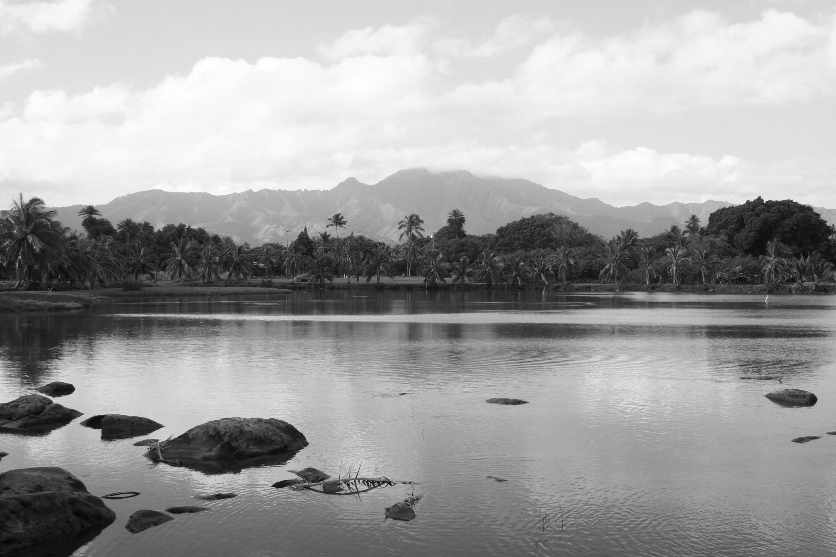
Who Am I & Why Am I Here?
Since January 2013, I’ve been working on an Archaeological Survey of Lokoea for LAD
And, an Archaeological Preservation & Development Plan

Slide 3
Topics I’d Like to Cover…
The Evolving Role of Archaeology in Hawai`i
Why and how we practice archaeology is changing
Lokoea in Context: Informing the Archaeological Survey
Cultural, historical, archaeological and physiographic evidence
Specific Archaeological Findings at Lokoea
Most of my presentation will focus on this

Slide 4
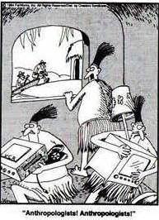
The “Good Old Days” when we were taught we had all the answers that mattered are (thankfully) over

Slide 5
Phrases you’d commonly hear in the past when confronted with an archaeological feature you weren’t sure about, or a scientific question that you believed could be answered:
“I’m not sure what that feature is, let’s dig a trench through it and we’ll find out.”
“When in doubt, chunk it out.”
Whereas today, you might hear something like this:
“Let’s leave it alone for now and see who might know something more about it.”
“I don’t know . . . let’s just leave it alone.”
At Lokoea, for example, we could probably obtain more accurate and specific information about the time of its origins and all of its phases of modification, but we need to ask ourselves how much destruction of the fishpond are we willing to live with to get these answers.

Slide 6
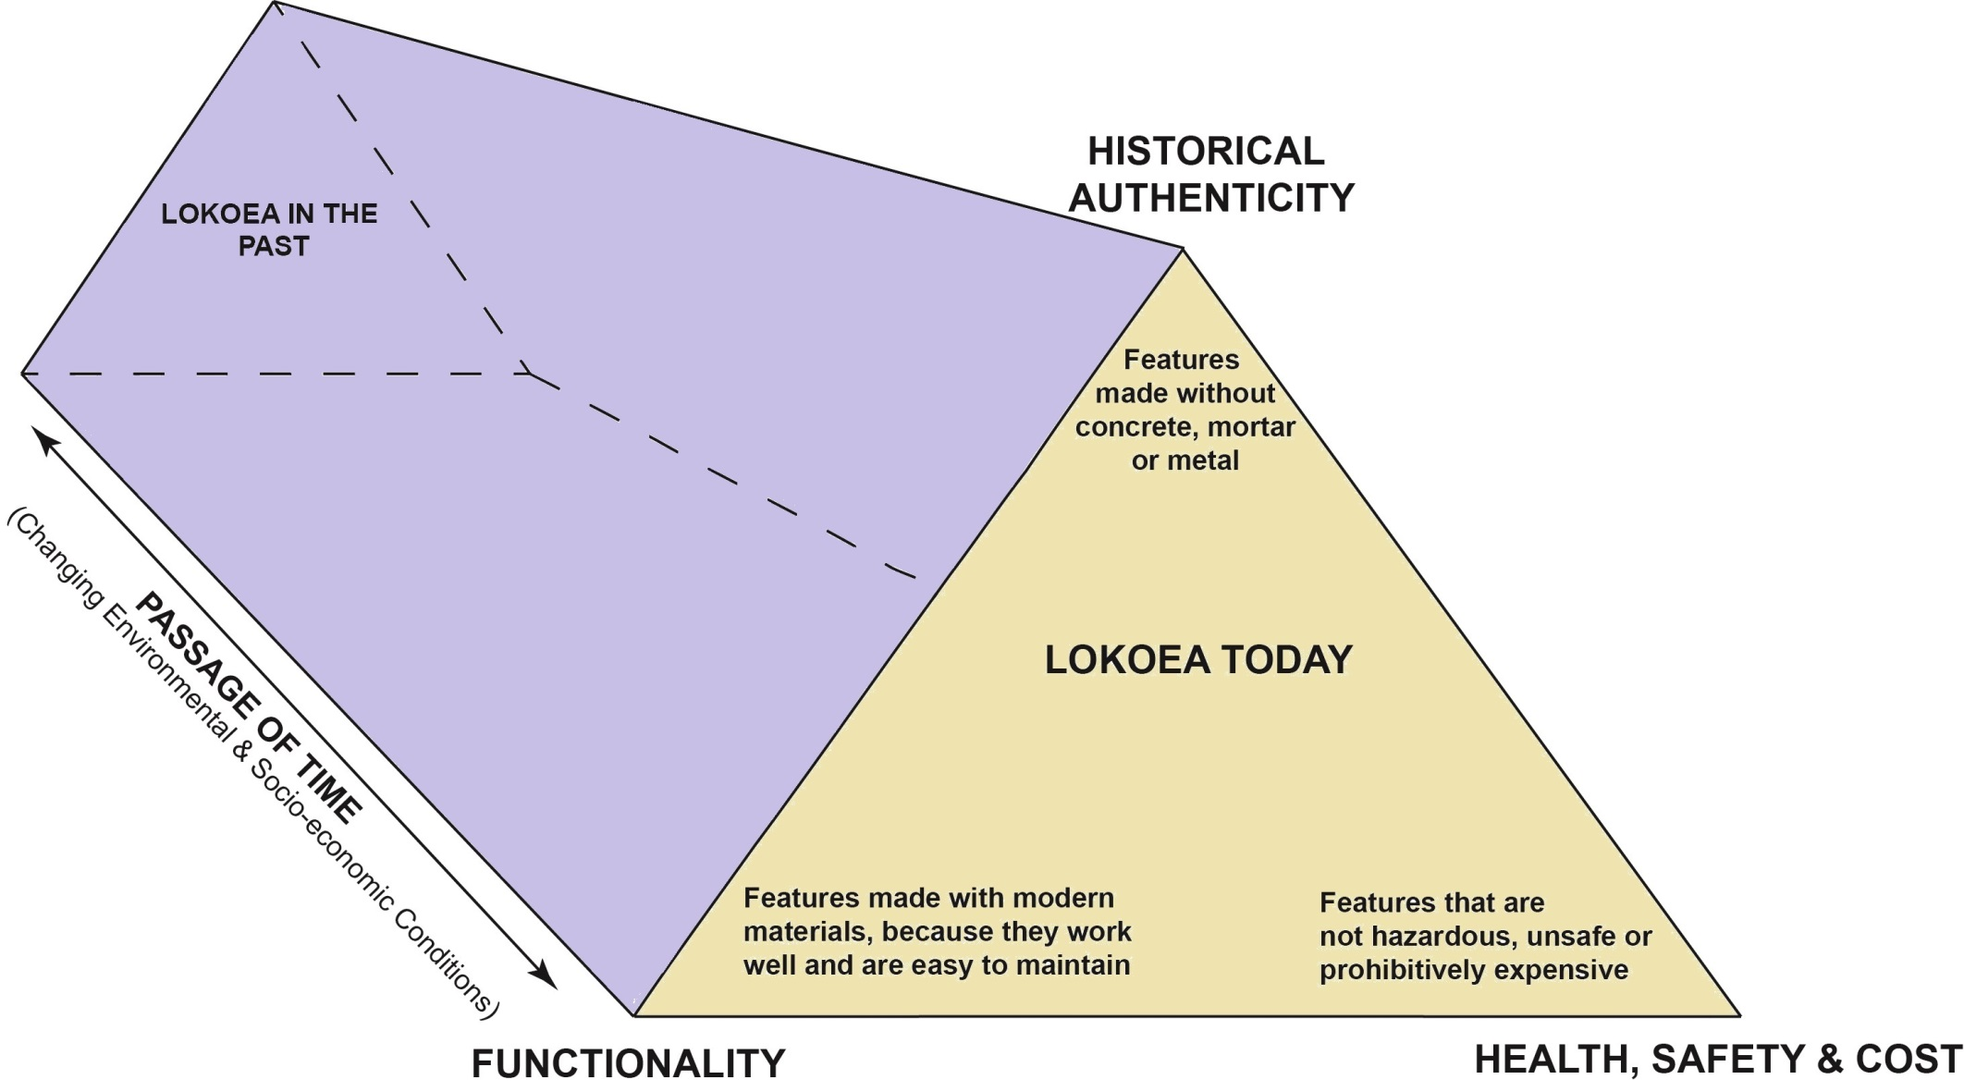
Archaeology in the Service of Site Preservation and Development at Lokoea

Slide 7
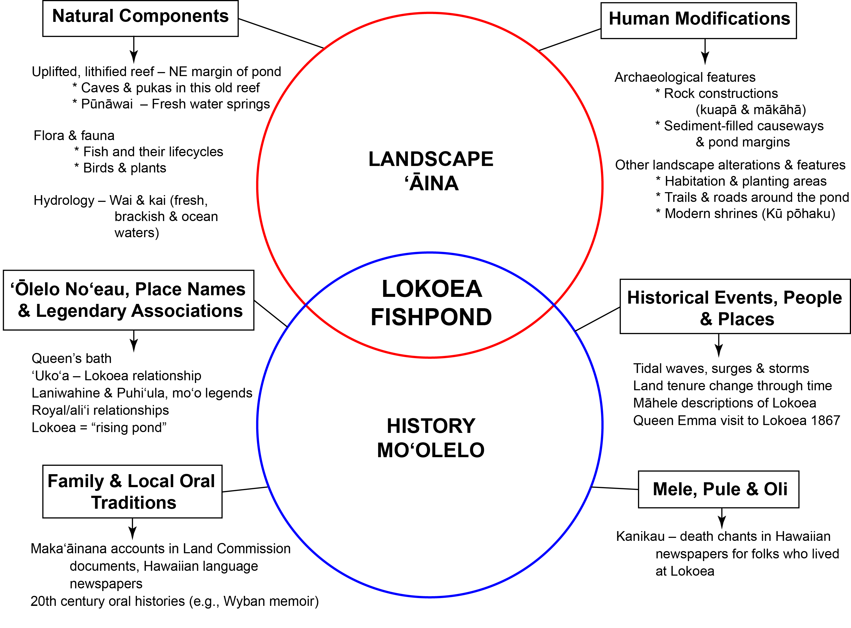
Working towards a New Paradigm in Hawaiian Archaeology

Slide 8
Lokoea (and `Uko`a) in Context
“Between the sandy stretch of Maeaea [Hale‘iwa Beach Park] and the houses at Ukoa, on the seaward side, was the trail from Kamani to the place in front of the sluice gate of Lokoea, and on to Koolauloa,” John Papa ‘Ī‘ī (translated by Mary Kawena Pukui) recollecting to around 1810
“Laniwahine was the kia`i of Uko`a, in Waialua, and Uko`a was the ‘long house’ (hale halau) in which she lived,” Waialua native, Samuel Kamakau (translation by Pukui); Kamakau’s testimony also emphasizes `Uko`a-Lokoea’s mystical/ esoteric nature and its “strange fishes.”
Hawaiian writings from the 19th century make it clear that `Uko`a and Lokoea were part of a whole, Lokoea being the “gates” of `Uko`a
Pukui’s translation of Lokoea as “rising pond” almost certainly refers to subterranean springs such as those along its east side; we identified two small caves that some believe are home to its mo`o, Laniwahine
I believe the name of the ahupua`a, Ka-wai-loa (the-long-water), refers to the more than one-mile-long fishpond complex (Laniwahine’s “long house”) of `Uko`a-Lokoea, which are intimately connected at all levels

Slide 9
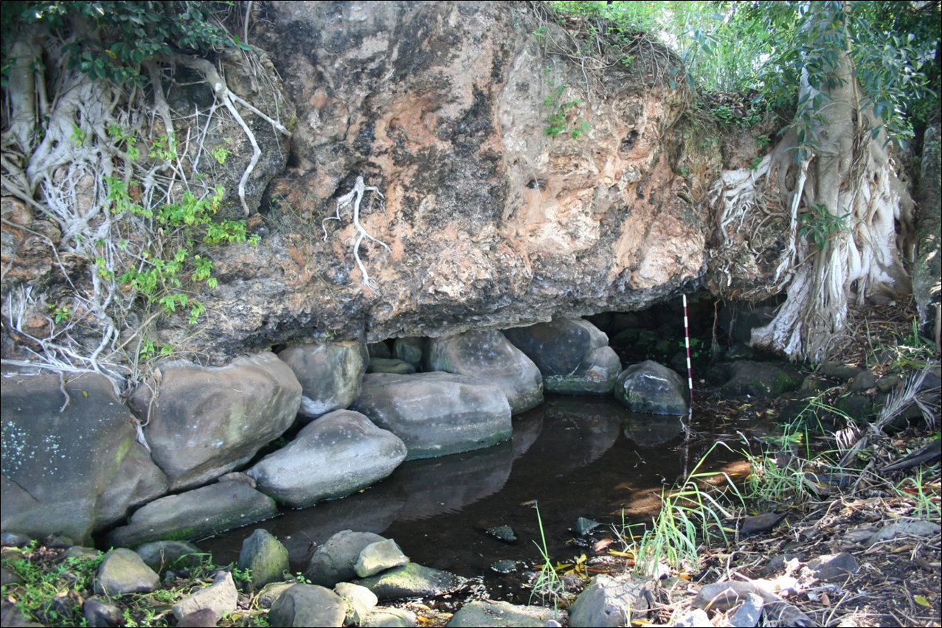
Here’s one of the small pūnāwai caves at Lokoea, a possible home of Laniwahine, illustrating its very unique geology

Slide 10
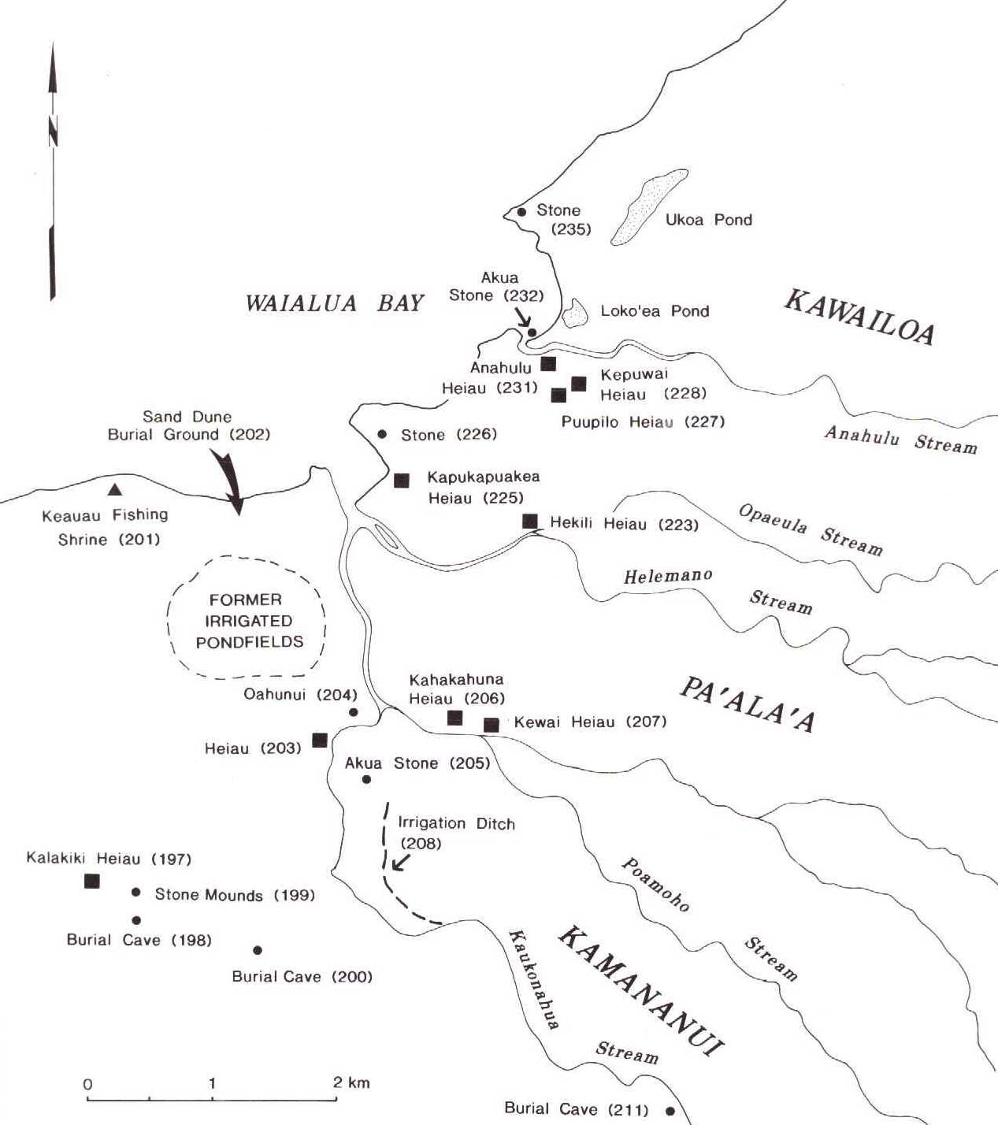

Slide 11
Maps & aerials
1 of 5
Physiographic constraints on Lokoea’s
size, shape & location on the landscape

Slide 12
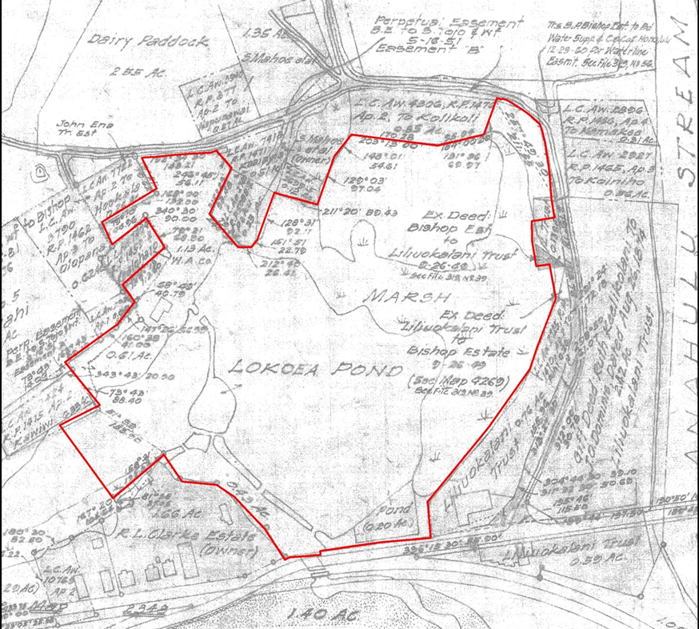
Maps & aerials
2 of 5
Portion of 1938-42 Bishop Estate survey

Slide 13
Maps & aerials
3 of 5
Shoreline variation 1928-1969

Slide 14
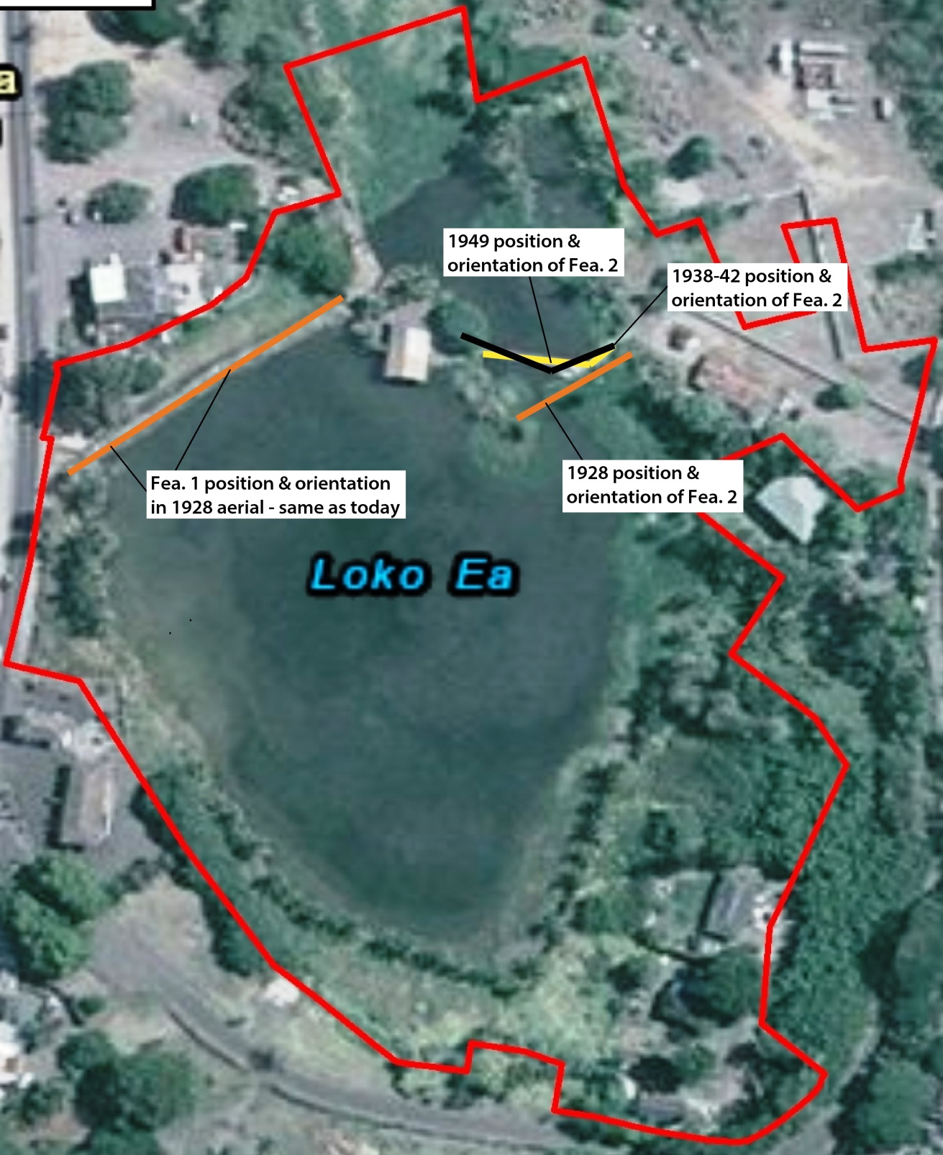
Maps & aerials
4 of 5
Change in location of Feature 2 from 1928

Slide 15
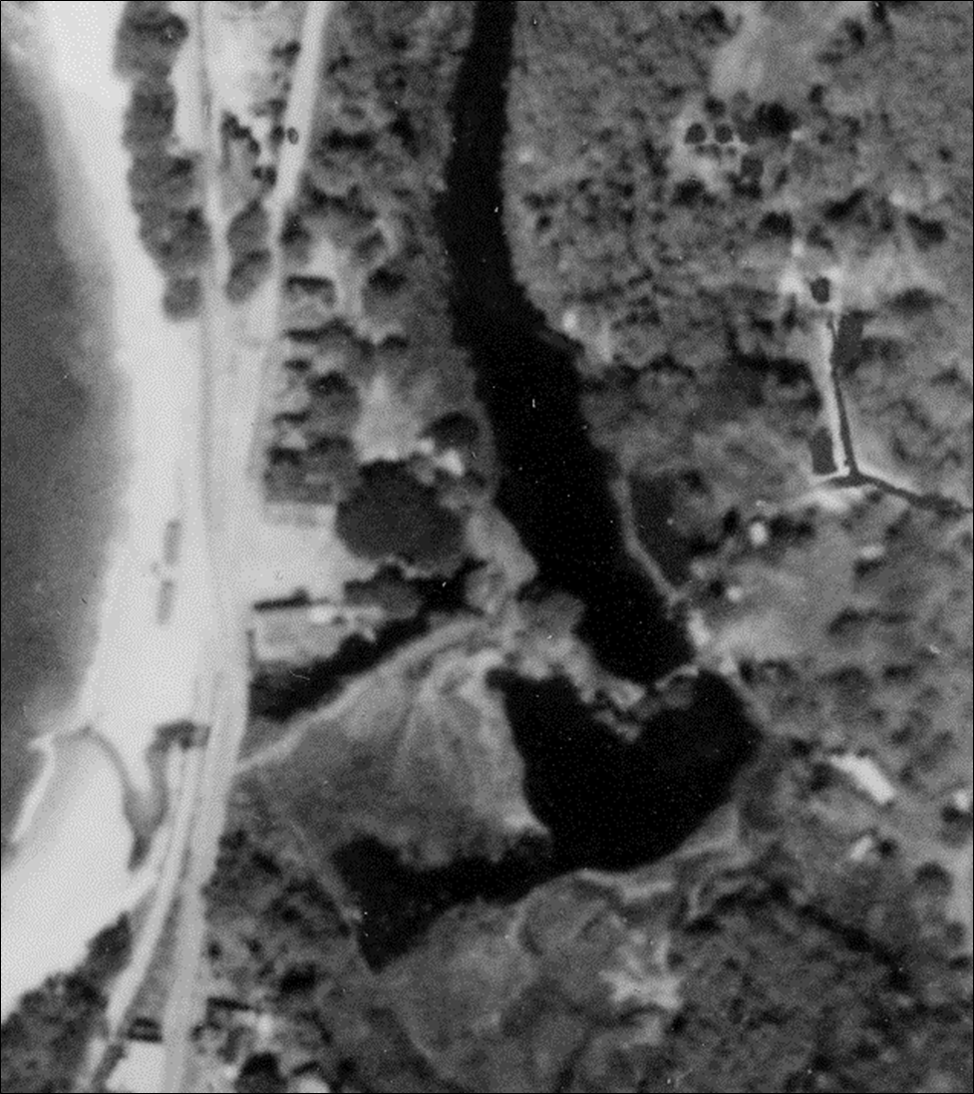
Maps & aerials
5 of 5
This 1928 aerial shows Lokoea in total disrepair, and the small wall (Feature 2) in a different location & orientation compared with all other (more recent) depictions
Central island
(Feature 4)
Feature 1 (large wall w. sluice gates)
Kamehameha
Highway
Feature 2 (small wall w. sluice gates
OR&L Railroad
Right-of-way

Slide 16
Some Historic-era Phases of Lokoea Modification
By the late 1920s, the fishpond was in serious neglect, disrepair
1930s, Waialua Sugar Co. seems to have invested in major repairs to the main structures and may have completely rebuilt the small wall (Feature 2) in a different location
1960s tenant embarked on extensive modifications including construction of the “Keiki pond”
1980s tenant rebuilt/ repaired parts of makai end of the large wall (Feature 1)

Slide 17
Archaeological Work at Lokoea
What do we want to know?
Origins and chronology (when questions)
Phases of change and modification through time (analysis of superposition)
Understand Lokoea as part of a larger cultural landscape
How did Hawaiians work with the natural lay of the land and transform the landscape to make it more productive in a sustainable way (i.e., without causing undue harm to its natural resources)?

Slide 18
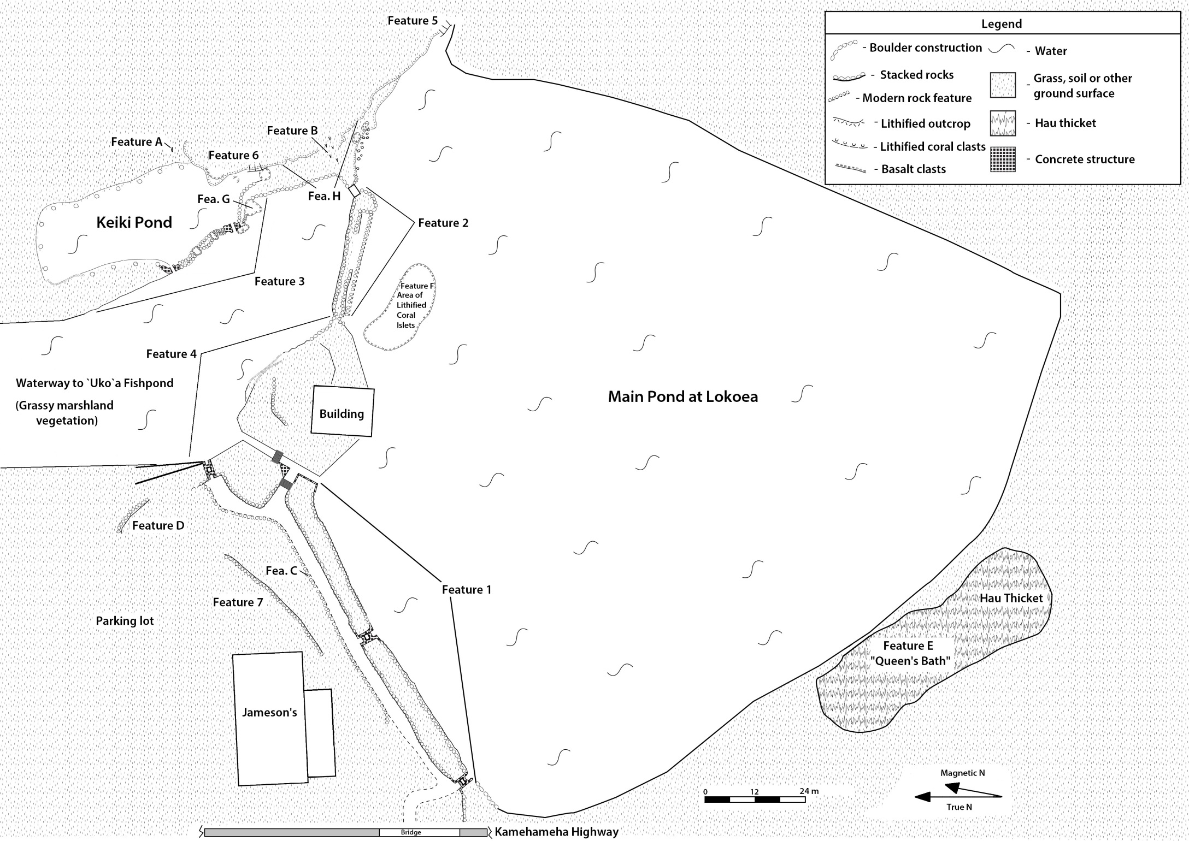
From a purely functional perspective, the large wall (Feature 1), small wall (Feature 2) & central island (Feature 4) collectively create Lokoea fishpond; without these 3 structures, Lokoea would simply be the south end of `Uko`a fishpond

Slide 20
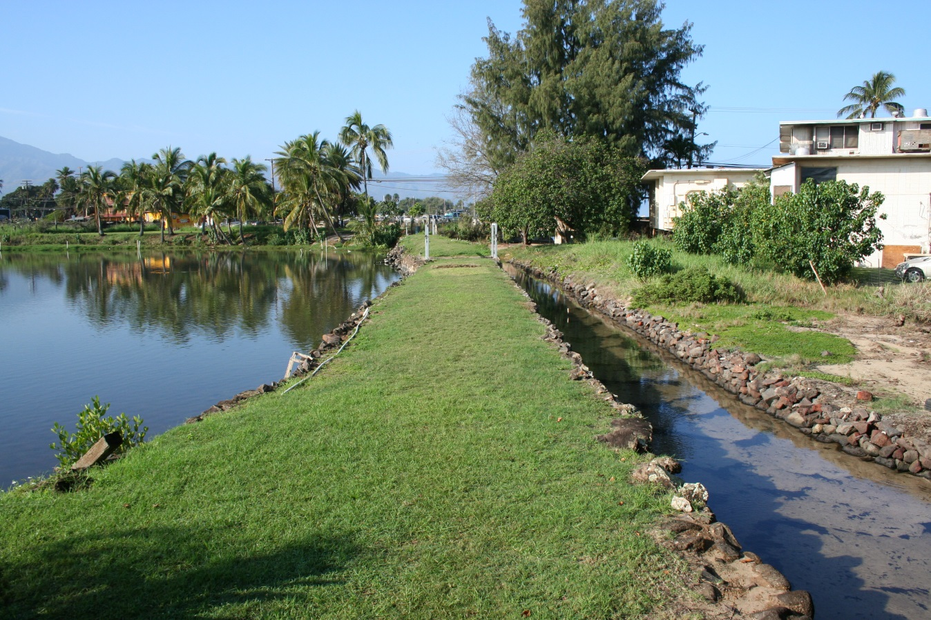
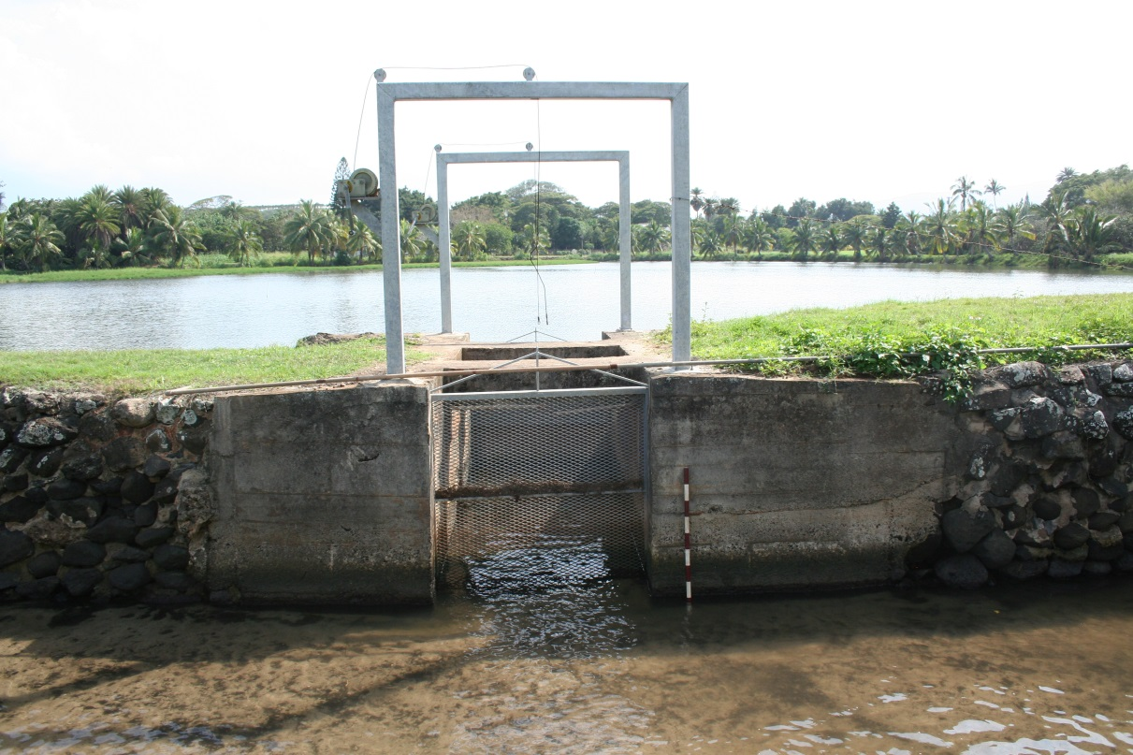
Large gated wall facing makai (Ka`ena), Lokoea Stream to the right, main pond to the left
Concrete and dressed basalt block gate structures built in 1930s

Slide 21
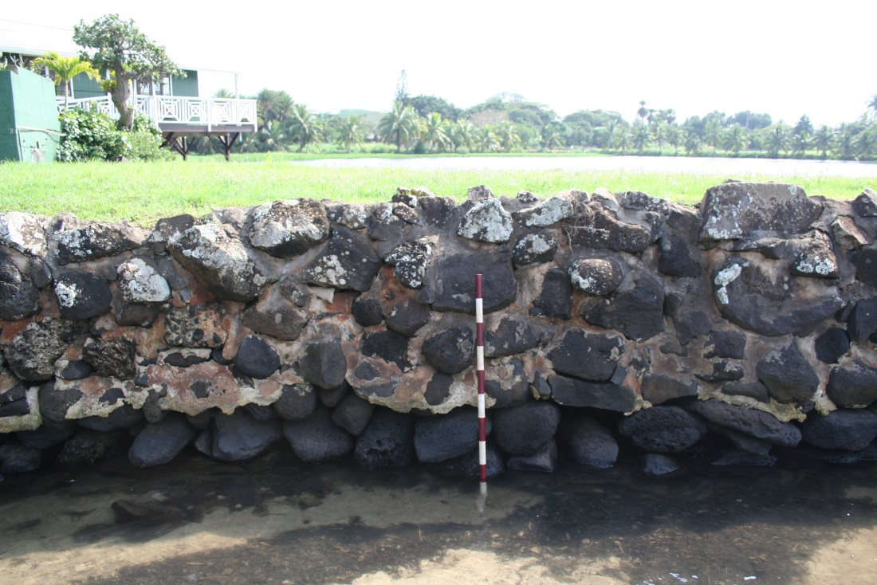
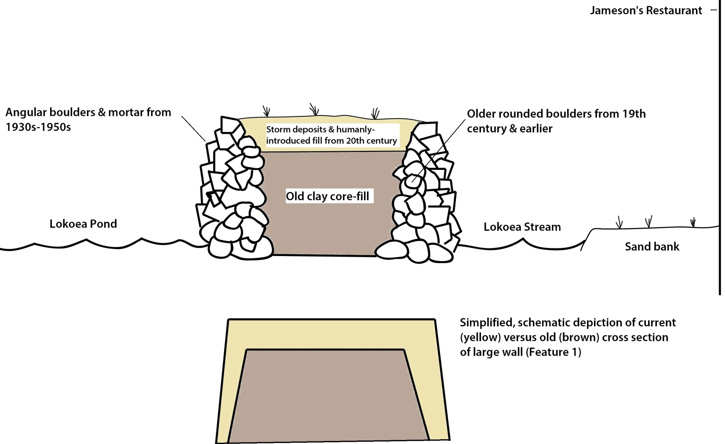
Newer (1950s) rock work overlying older (rounded dark boulders)
Schematic cross section of Feature 1

Slide 22
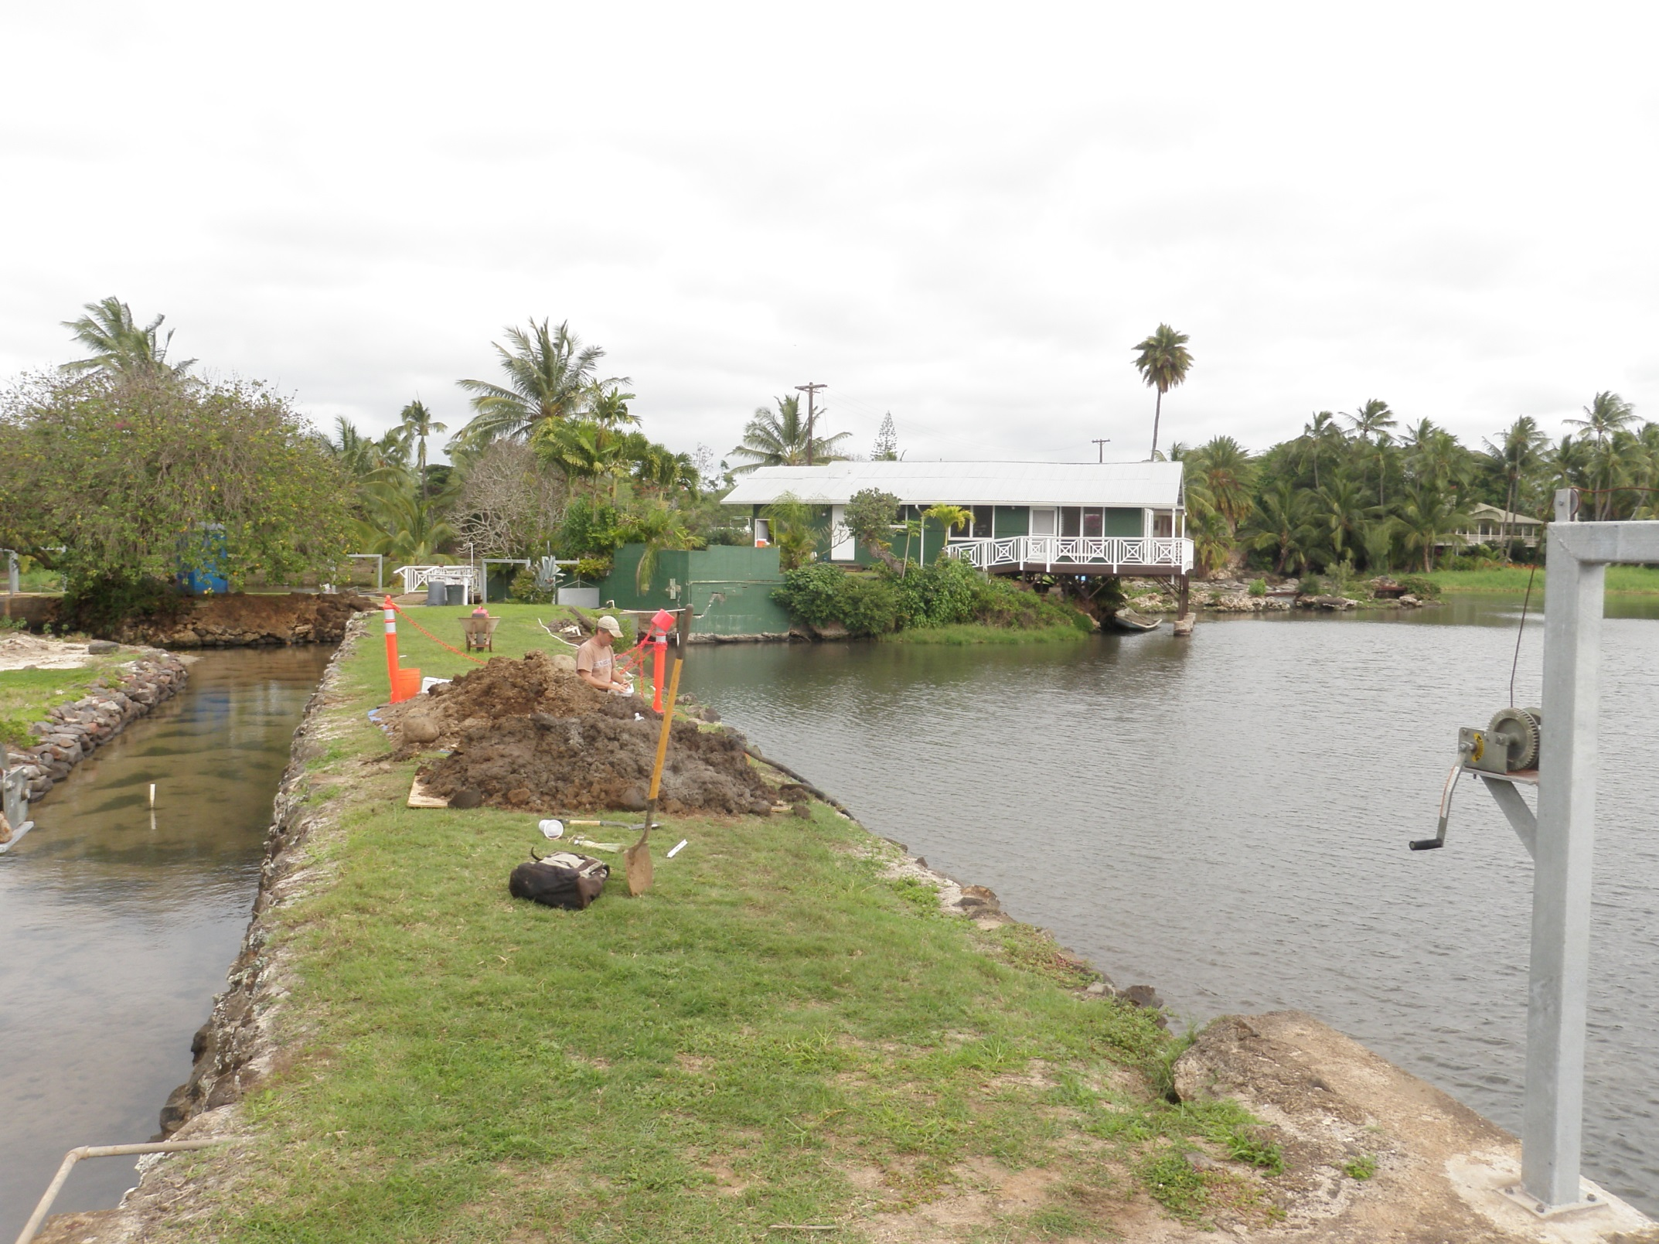
Excavation (test unit 1) in the large wall (Feature 1) Purpose of digging in this spot? [Incidentally, all our excavation done only by hand]

Slide 23
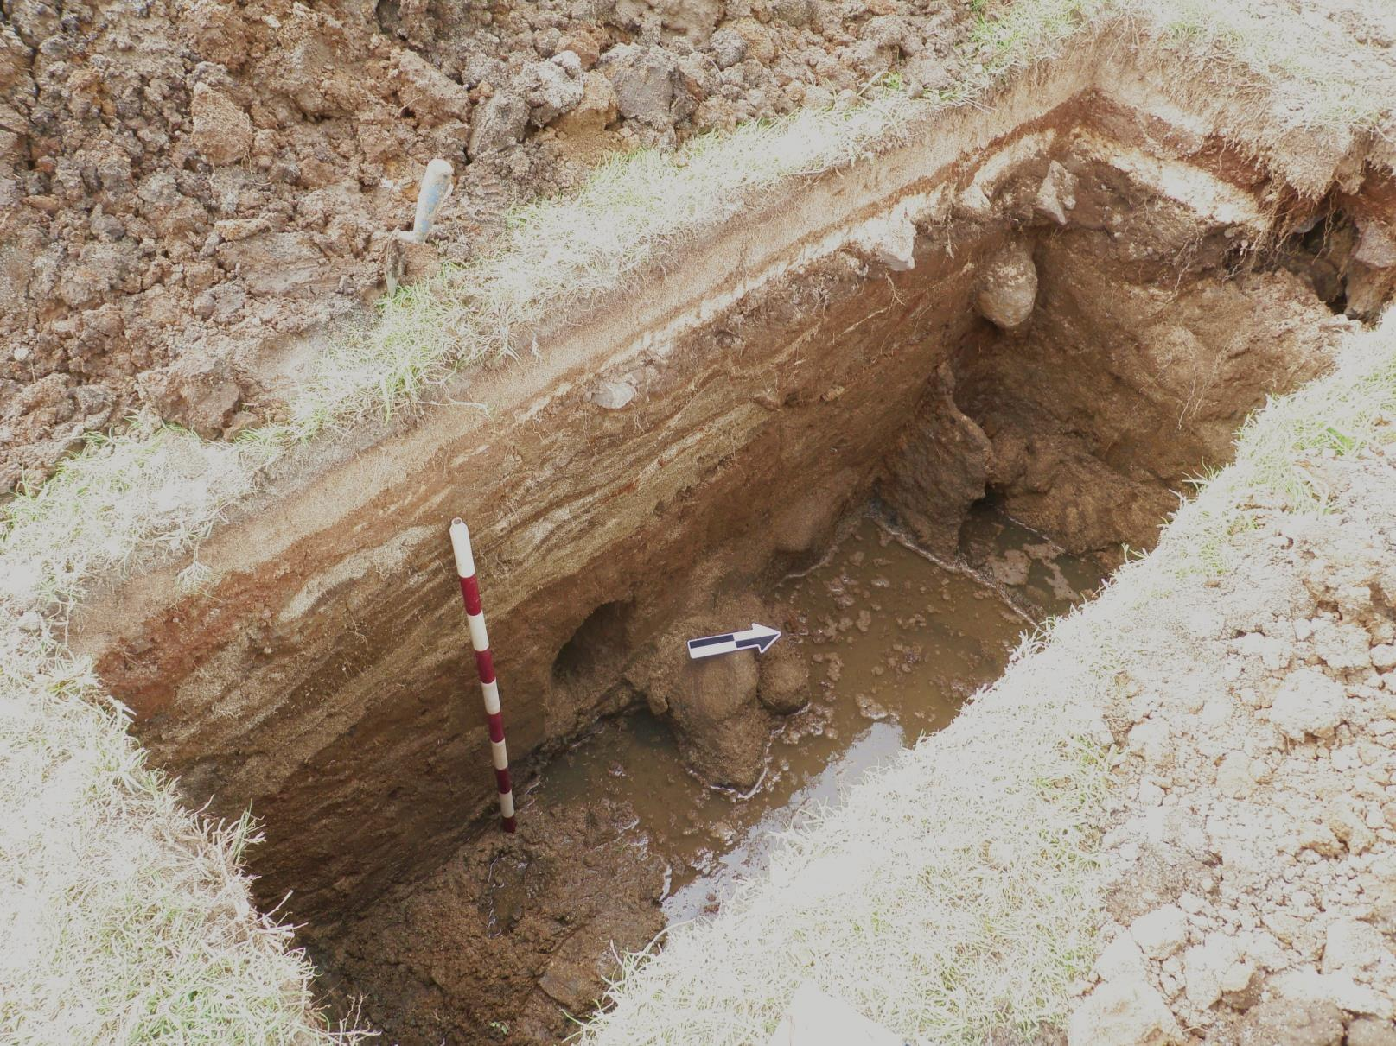

Slide 24
Detail of sheet metal shoring (1930s material) at the very base of excavation, in the water table

Slide 26
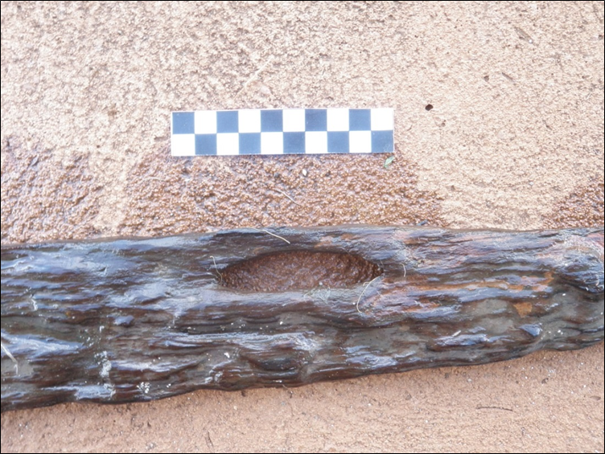
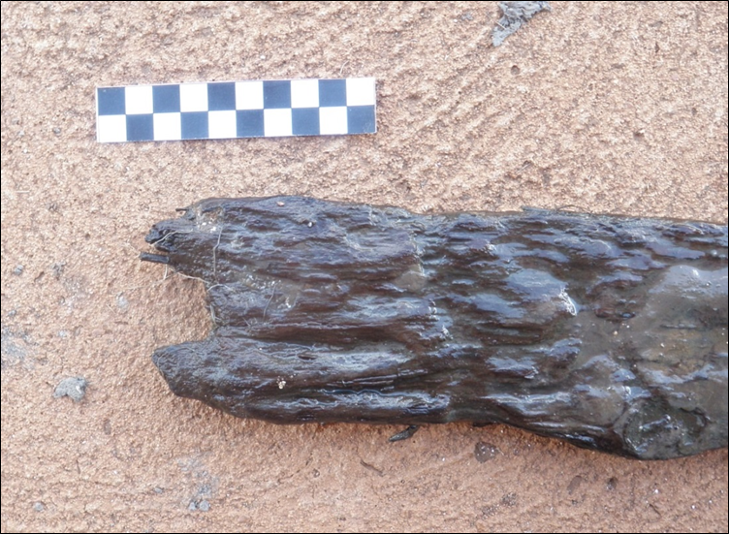
This object is about 32 inches long,
a bit less than 3 ft

Slide 28
Radiocarbon dating & taxonomic identification
Douglas fir (a native of the western U.S.)
AD 1760–1820
In the context of the evidence of the 1930s sheet metal shoring at the bottom of the trench, what does this all mean?
Either the large wall (Feature 1) isn’t very old, or it has been more or less completely rebuilt from the bottom up; regardless, this excavation and other work we did at the makai end suggest it’s difficult to find undisturbed/ unmodified parts of this wall

Slide 29
Excavation (test units 3 & 4) in makai end of large wall Purpose for digging here?
Test unit 3
Location of test unit 4

Slide 30
Test unit 3
Except for very bottom of this trench, original wall (Feature 1) linking up with sand dune is gone, washed away

Slide 31
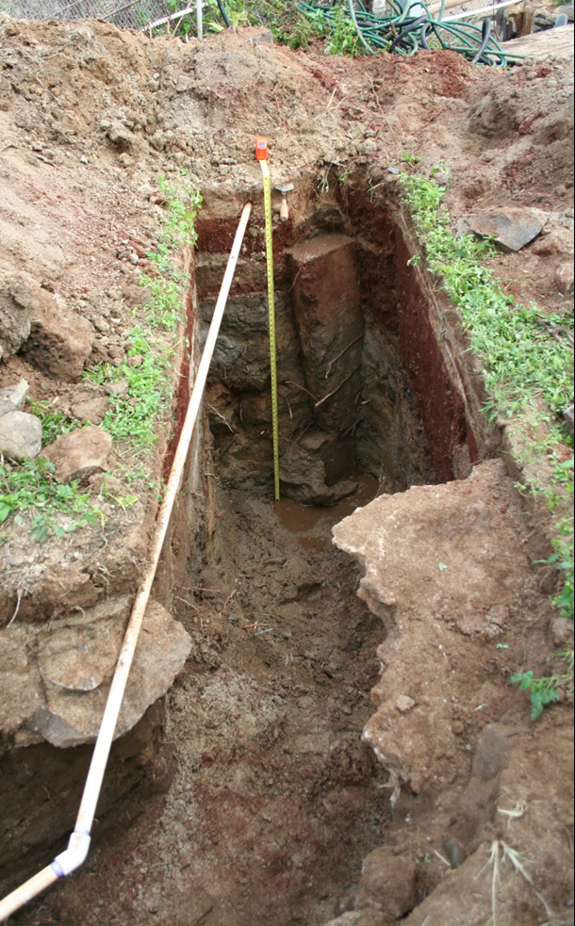
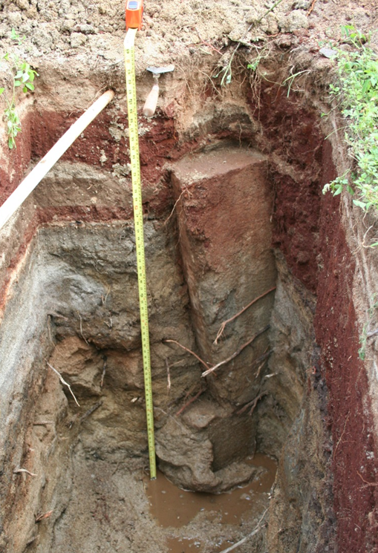
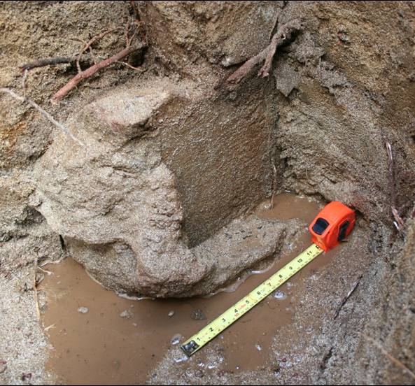
Buried (subsurface) concrete gate makai of existing (1930s) gate; this older gate was built about 1 ft lower than the existing (1930s) gate, and it was a much less imposing structure
Test unit 4-immediately adjacent to test unit 3

Slide 32
What do both of these excavations at the makai end of the large wall tell us?
It’s difficult to find old, undisturbed sections of this wall, although we found what appear to be rounded boulders in natural sand at the bottom of test unit 3
This makai end of the wall has been damaged, knocked out, repaired many times due to storms, tidal surges, tsunami
The buried structure in test unit 4 probably dates to the period of disrepair in the 1928 aerial photograph

Slide 33
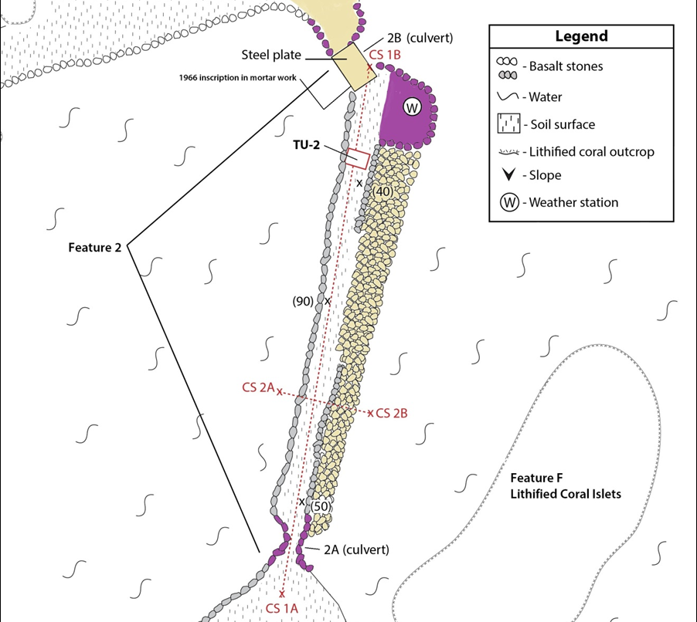
Excavation (test unit 2) in small wall (Feature 2) Purpose of digging in this spot?

Slide 34
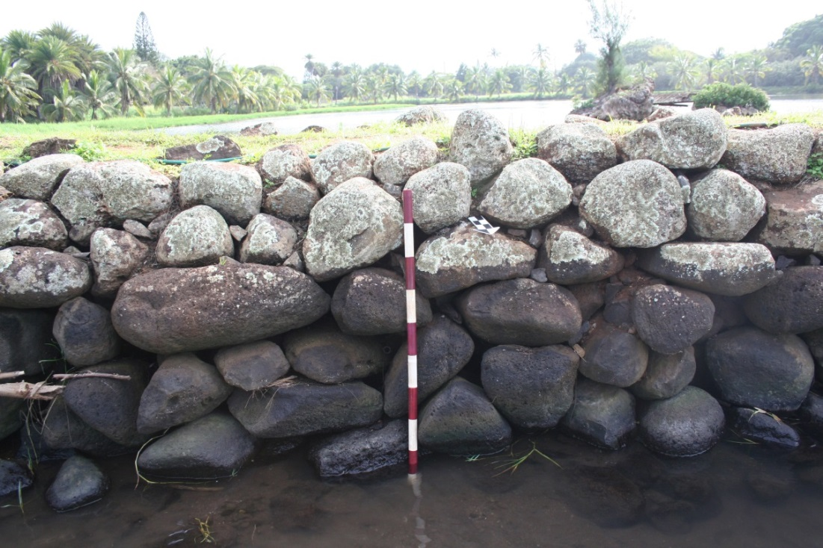
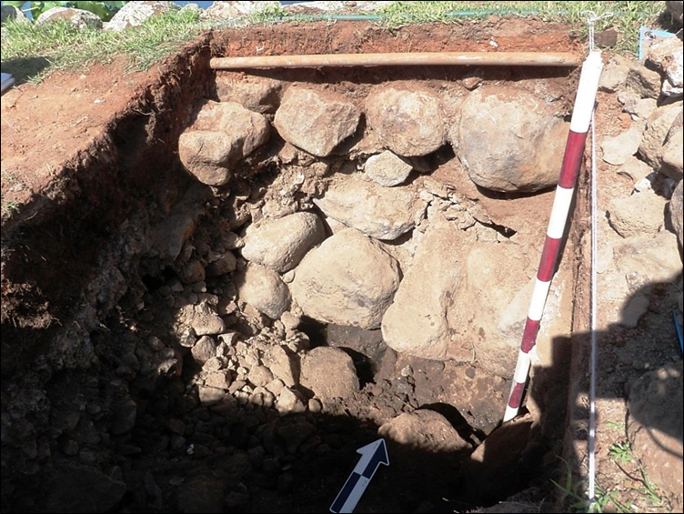
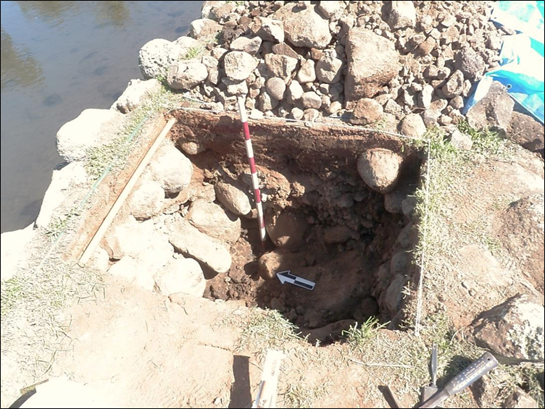
Excavation demonstrated the most traditional-looking wall was constructed by core-and-fill method (interior filled with rock rubble down to water at about 3 ft below surface)

Slide 35
Excavation (test unit 5) in the central island Purpose of digging?

Slide 36
Test unit 5 – eventually excavated to 125 cm (just over 4 ft) below surface

Slide 37
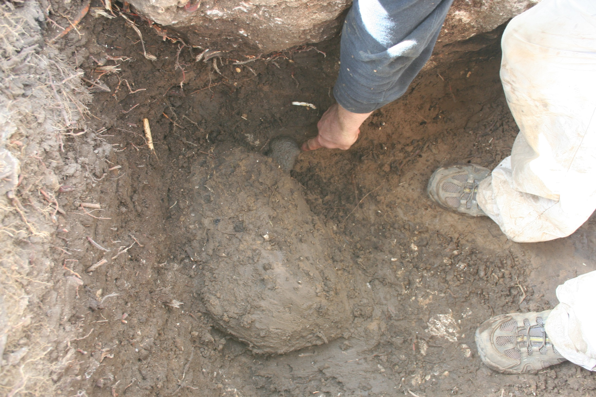
Traditional basalt net weight 92 cm (just over 3 ft) below the surface

Slide 38
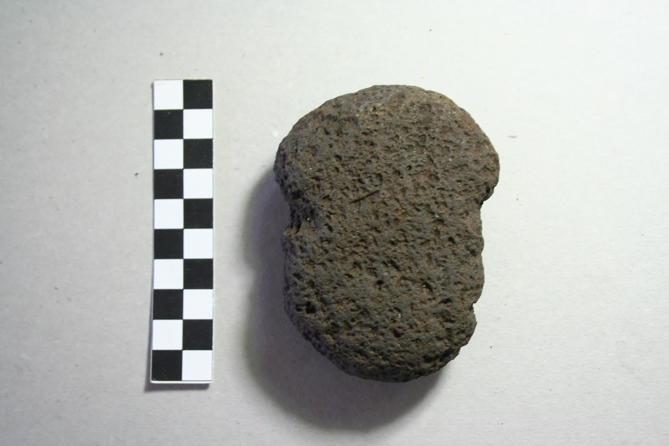
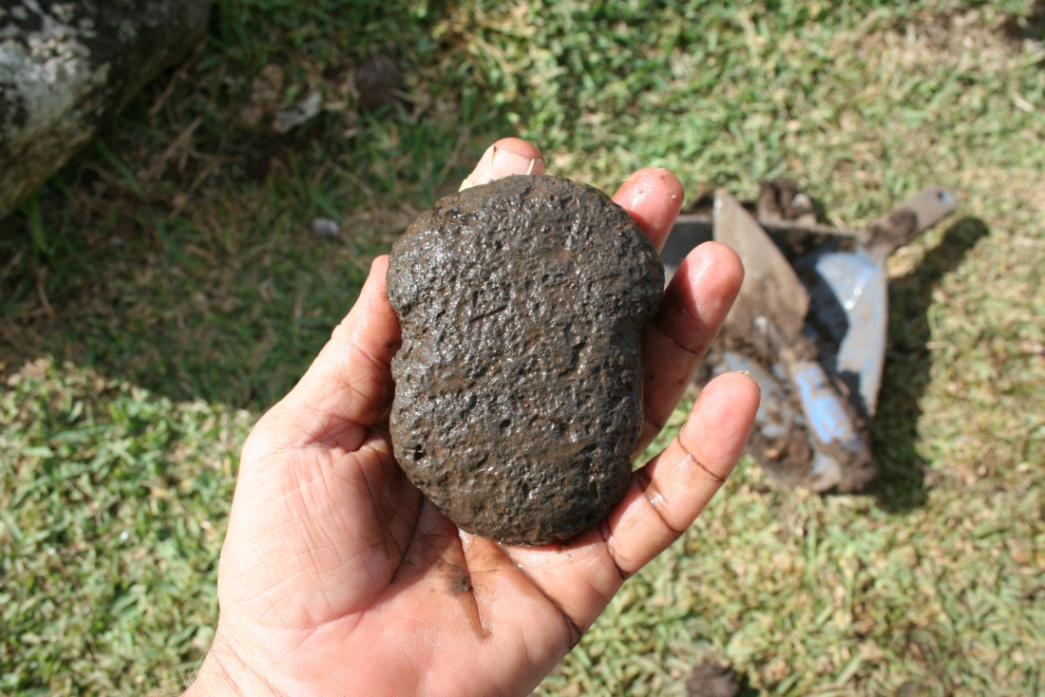
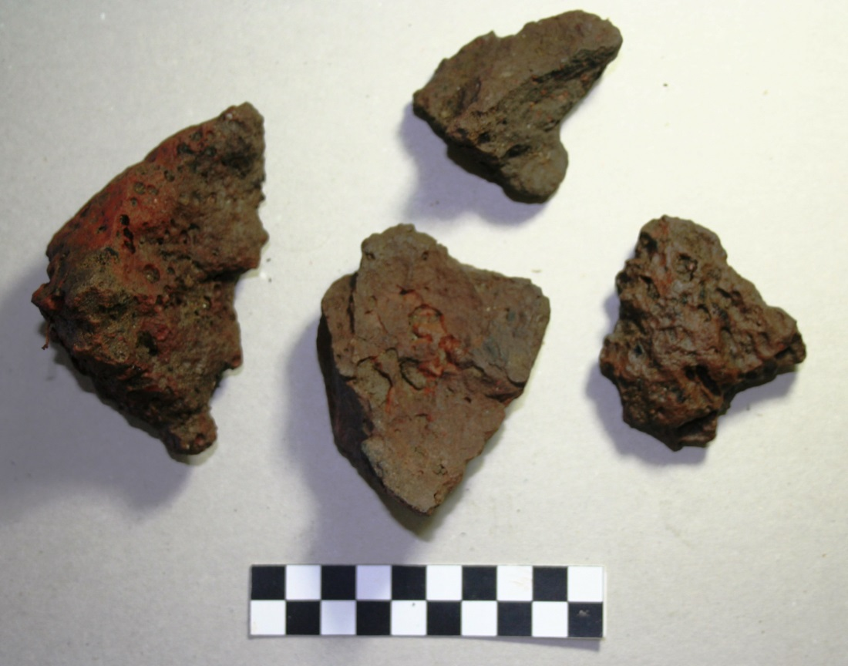
Basalt net weight is notched on both sides (yellow arrows)—this notch would have been where net cordage wrapped around it.
We also found fire-affected rocks in direct association below about 3 ft in depth (left image)

Slide 39
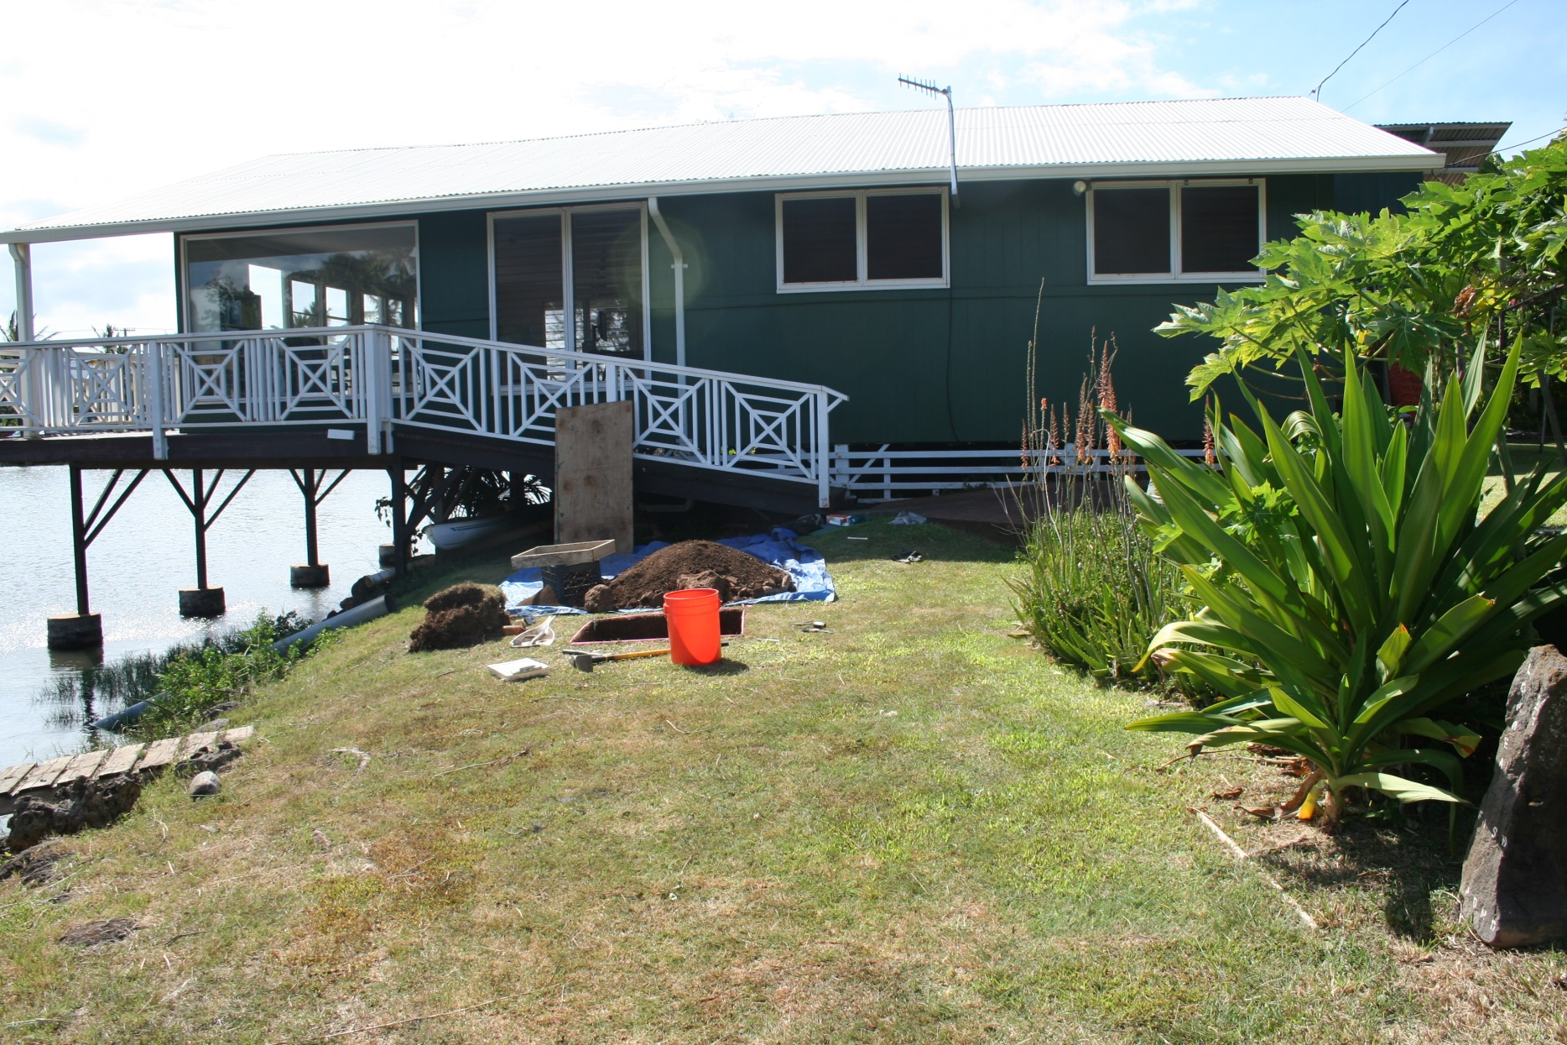
We’re in the process of another excavation (test unit 6) on the other side of the central island

Slide 40
Where are we likely to find significant cultural resources below the ground surface in the future? Red means “be careful!” Green means “no problem”

Slide 41
Summarizing: Some Archaeological Topics to Discuss
How old is Lokoea?
Of course it dates from “pre-Cooke” times, but can we get more precise?
Where are we going to find undisturbed evidence from centuries ago? Up on the bluff?
Can we do “underwater archaeology” at Lokoea?
Underwater archaeology is more technical and costly, but it could yield tremendous information
Can work together in the future to obtain more (terrestrial) archaeological information at Lokoea?
Monitoring during infrastructure improvements?
Major research program funded by outside grants?

Slide 42
Mahalo!
Jason Jeremiah
Sean McNamara
James Estores (Mālama Loko Ea Foundation)
Jessica Casson (Mālama Loko Ea Foundation

